Slide 1

Mandatory Opt-In
COMP 4730 – Case Study
Alex Lewin

Slide 2
Background
Traditionally, companies sold software to users.
User gives $ → Company gives access to product.
Today, many companies give software/services to users for free.
User gives information → Company gives access to product.

Slide 3
Examples

Slide 4

Honey
Free Chrome extension that automatically finds coupons for the user.
User gives browsing/shopping data.
Honey gives coupons.

Slide 5

Credit Karma
Free service to lookup your credit score.
User gives access to financial data.
Credit Karma provides a free credit score.

Slide 6
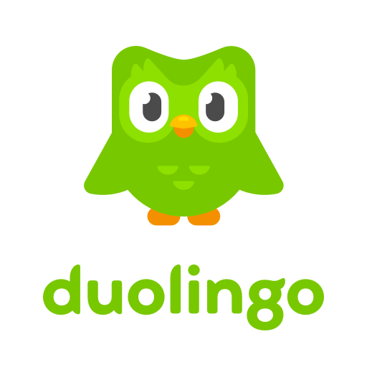
Duolingo
Free app to learn new languages
User trains ML models for translation.
Duolingo gives educational resources.

Slide 7
Pros
This is evidence of a thriving free market.
Companies should be applauded for inventing creative business models where consumers do not need to pay.
Users are given access valuable products for free.
The relationship is entirely consentual, nobody is required to use these free services.

Slide 8
Cons
This "quid-pro-quo" relationship may violate consumers’ right to stay anonymous.
This relationship is fundamentally coercive – most consumers do not understand what they are giving up.

Slide 9
Facebook – Cambridge Analytica Scandal
Users opted-in to using free apps.
Opting-in gave consent to access your data and your friends’ data
87 million users affected
What people thought was being collected: Public profile, page likes, birthday and current city
What was also being collected: news feed, timeline, messages, and precise GPS location

Slide 10
My Opinion
Pro
I think the value consumers get from free software far outweighs the potential drawbacks.
Generally, people are more than happy to give up information for free services.

Slide 11
Question
Does this exchange - information for free software - violate consumers’ right to stay anonymous?

